Slide 1
From The Author…
This is not the only strategy to teach fractions however it is how I have done it after 20 years of teaching students with learning difficulties where the focus has been on closing the gap in the learning + helping students connect and engage with the maths concept being explored.
As part of this MEGA KIT, I encourage you to take in from my shared experiences and then apply what you feel, works best for your student/s. YOU are a teacher and you have the choice to select the planned learning and it is this process where you learn the most!
My advice is to learn to love feedback and use it to reflect on your teaching and their learning… for best practice!
Students help you become the best teacher you can be!
If you need to use all my resources and training, go for it and then when you are comfortable and confident with the content, start to bring in your flavour to the learning + HAVE FUN!!!
Rachel xox
MATHS MEGA KIT
+
ONLINE
COURSE

Slide 2
Teaching Fractions
PART OF THE MATHS MEGA KIT + ONLINE COURSE
Fractions Unit
Contains editable PowerPoint slides that can convert to worksheets, white board for interactive slides and learning support tasks.
Starts with how to introduce and moves through to applying to problem solving examples.

Slide 3
Teaching Fractions
PART OF THE MATHS MEGA KIT + ONLINE COURSE
TEACHER TRAINING;
Learn to create your own PowerPoints and interactive slides;
Use the PowerPoint immediately once you download;
Build confidence in teaching tricky maths concepts;
Access details here:
https://www.boosteducation.com.au/product-page/maths-mega-kit

Slide 4
Language Support & Conditioning
When introducing new concepts to students, I highly encourage all teachers to spend time exploring the language that students use and the meanings behind different words.
This is due to the fact that everyone has different meanings around concepts, words, symbols, images etc… which NLP (neuro linguistic programming) research and psychology refers to as “conditioning”.
We each have our own conditioning which heavily relies on our own experiences in life, which are unique as our finger prints!
Therefore, clearing up definitions and validating meanings about topics is one of the vital early steps as a teacher, to close the gaps in the learning.
It also provides the opportunity for you as teacher to find out ‘where’ your students are at and what a ‘point of reference’ could be as you collect their prior knowledge and understandings.

Slide 5
Learning Framework
FRACTIONS
Collect Prior Knowledge
(pre-test as whole class or work sample)
Discuss all Meanings around an Example of a fraction or ’parts of’
(could be a word problem or a number or an image or maths symbol)
Explore ‘why would we need to know this’ & if it links to previous work the class have explored – ie, percentages ?
(make predictions and talk about real life situations)
Deconstruct A Problem + Apply New Concept
(model in whole class and repeat in groups)
Discuss a ‘stretch’ or new knowledge from the lesson
(discuss the ‘how’ to keep a record of what they learn for future)

Slide 6
Language Support + Scaffolding
FRACTIONS
Collect words and language used for the age group you are teaching;
Use terms interchangeably and support students
Explore ‘why would we need to know this’
(make predictions and apply to real life situations)
Discuss the use of an Anchor Chart
(discuss the ‘how’ to keep a record of what they learn for future)

Slide 7
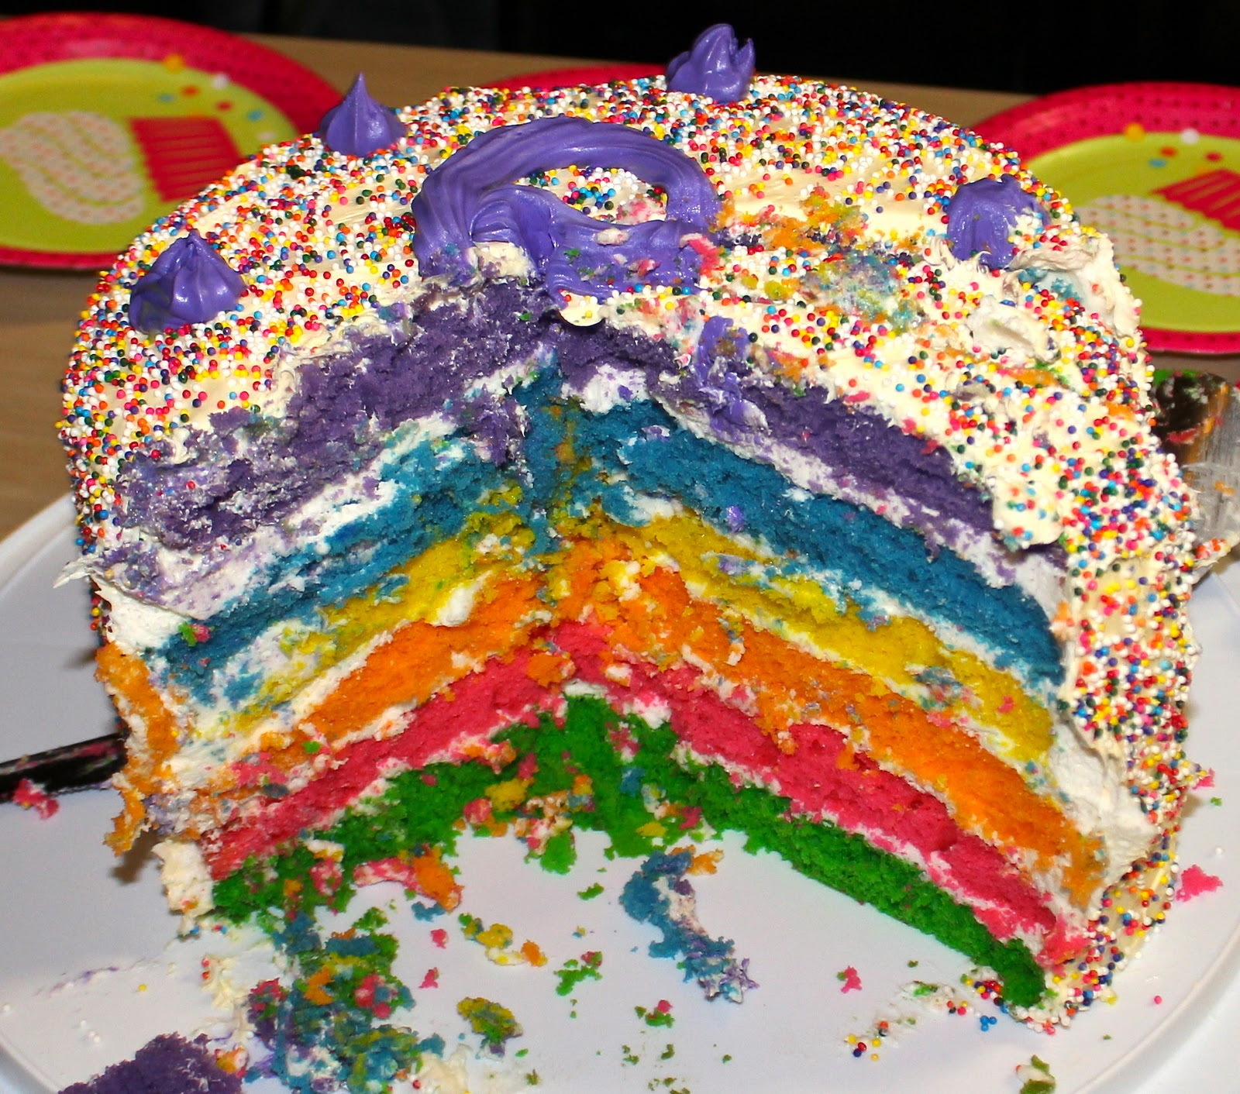
FRACTIONS
HOW CAN WE SPLIT THE CAKE?

Slide 8
FRACTIONS
HOW CAN WE SPLIT THE CAKE?

Slide 9
FRACTIONS
HOW CAN WE SPLIT THE CAKE?

Slide 10
What if the shape was as a different shape ?

Slide 11
What if the shape was as a different shape ?

Slide 12
fractions
What do you know about this word?
half

Slide 13
fractions
What do you know about this symbol?
I U

Slide 14
What do you know about this?
1
2

Slide 15
What if the shape was as a different shape ?
1 | = | 1
1
1 | = | 1
1

Slide 16
What if the shape was as a different shape ?
1 | = | 1
1
2 | = | 1
2
1 | = | 1
2

Slide 17
What if the shape was as a different shape ?
3 | = | 1
3
1 | = | 1
1

Slide 18
Does the shape / cake change from being 1 ?
1 | = | 1
1
2 | = | 1
2

Slide 19
How else can we draw this ?
2 | = | 1
2

Slide 20
What if the shape was as a different shape ?
1 | = | 1
1
2 | = | 1
2
How many coloured in ? | = | 1
Number of pieces ? |  | 2

Slide 21
1.0
Fractions
10 | = | 1 | = | 2 | = | 3
10 |  | 1 |  | 2 |  | 3

Slide 22
Fractions
1 | = | 1 | = | 2 | = | 3 | =
 |  | 1 |  | 2 |  | 3 |  | 4 |  | 5

Slide 23
Fractions
1 | = |  | = |  | = |  | =
 |  | 1 |  | 2 |  | 3 |  | 4 |  | 5

Slide 24
fractions
What do you know about this ?
100%

Slide 25
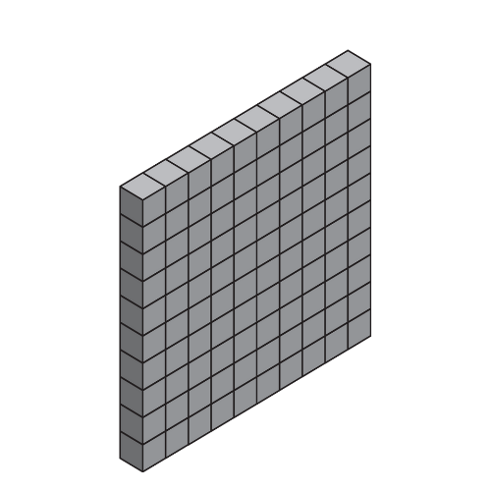
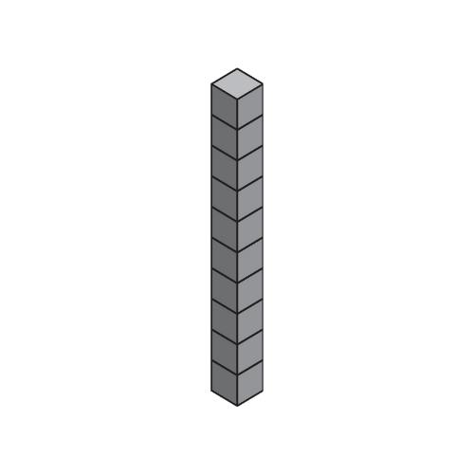
These concepts are taught in the Maths Mega Kit…
Fractions
Percentages
Decimals
10 | = | 100% | = | 1.0 | = | 100
10 |  |  |  |  |  | 100

Slide 26
Teaching Fractions
PART OF THE MATHS MEGA KIT + ONLINE COURSE
TEACHER TRAINING;
Learn to create your own PowerPoints and interactive slides;
Use the PowerPoint immediately once you download;
Build confidence in teaching tricky maths concepts;
Access details here:
https://www.boosteducation.com.au/product-page/maths-mega-kit

